Slide 1
Learning ASP.NET Core Internationalization
Internationalization involves Globalization and Localization. Globalization is the process of designing apps that support different cultures. Globalization adds support for input, display, and output of a defined set of language scripts that relate to specific geographic areas.
Localization is the process of adapting a globalized app, which you have already processed for localizability, to a particular culture/locale.

Slide 2
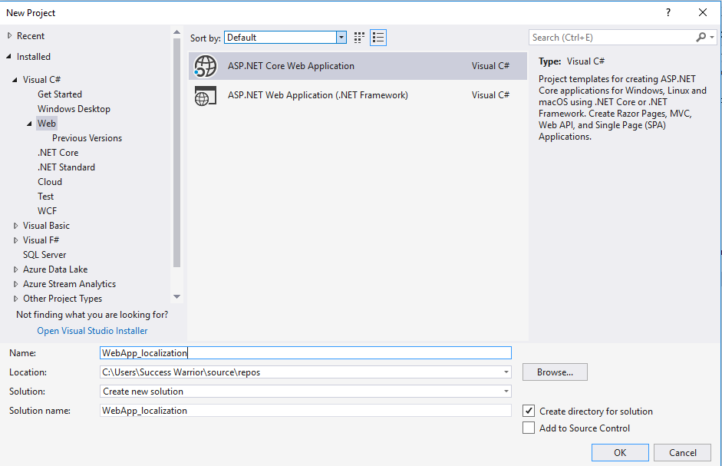

Slide 3
